Slide 1
Proofs to Algorithms for High-Dimensional Statistics
Samuel Hopkins
Miller Fellow, UC Berkeley
Notes:
Hi, everyone, it’s extremely exciting to be here!

Slide 2
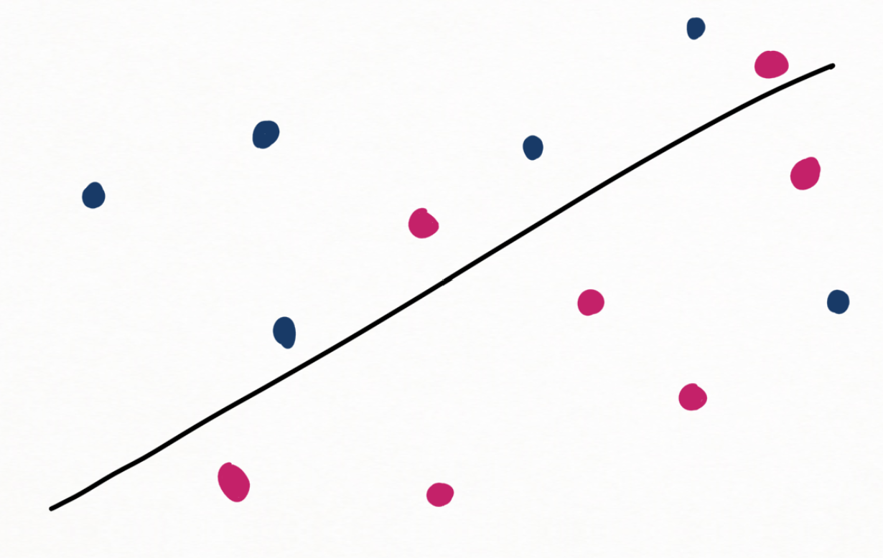
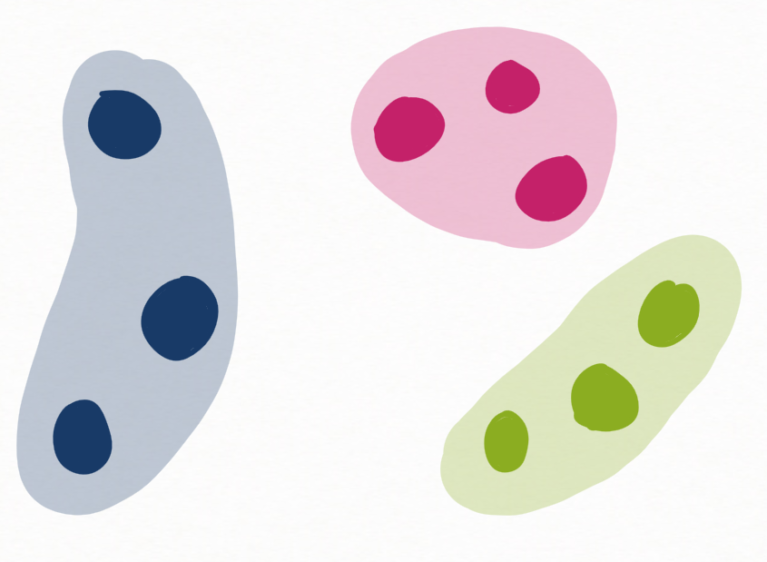
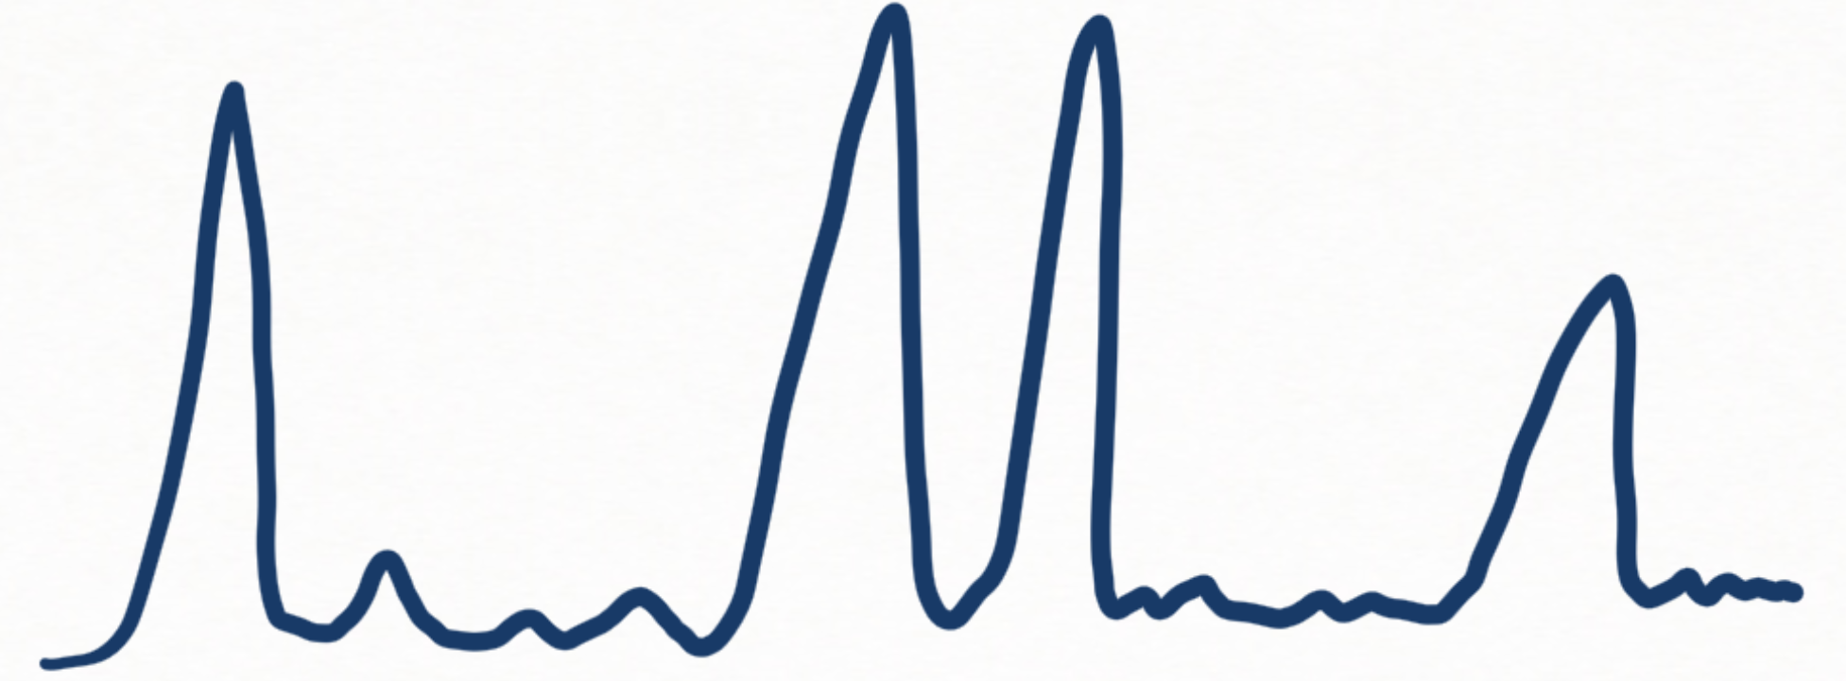
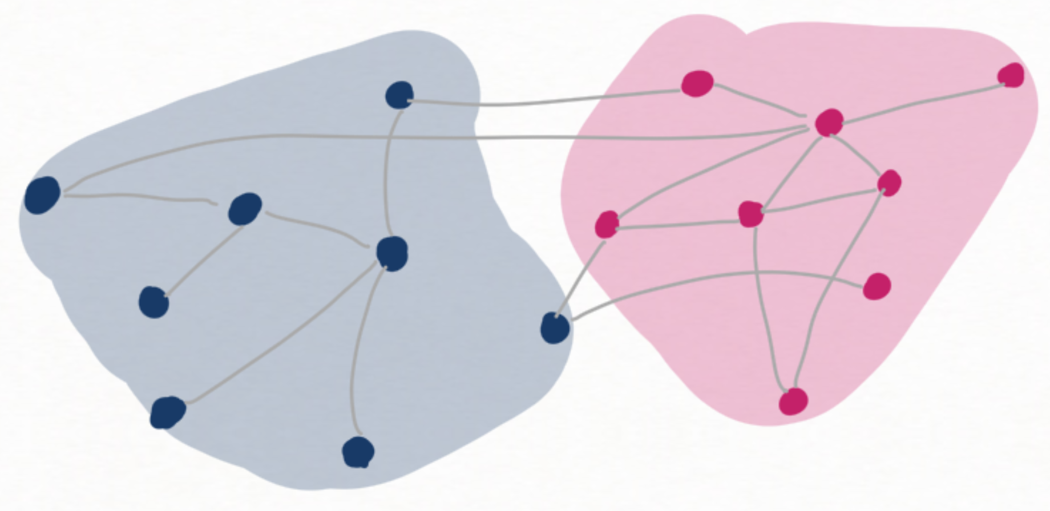
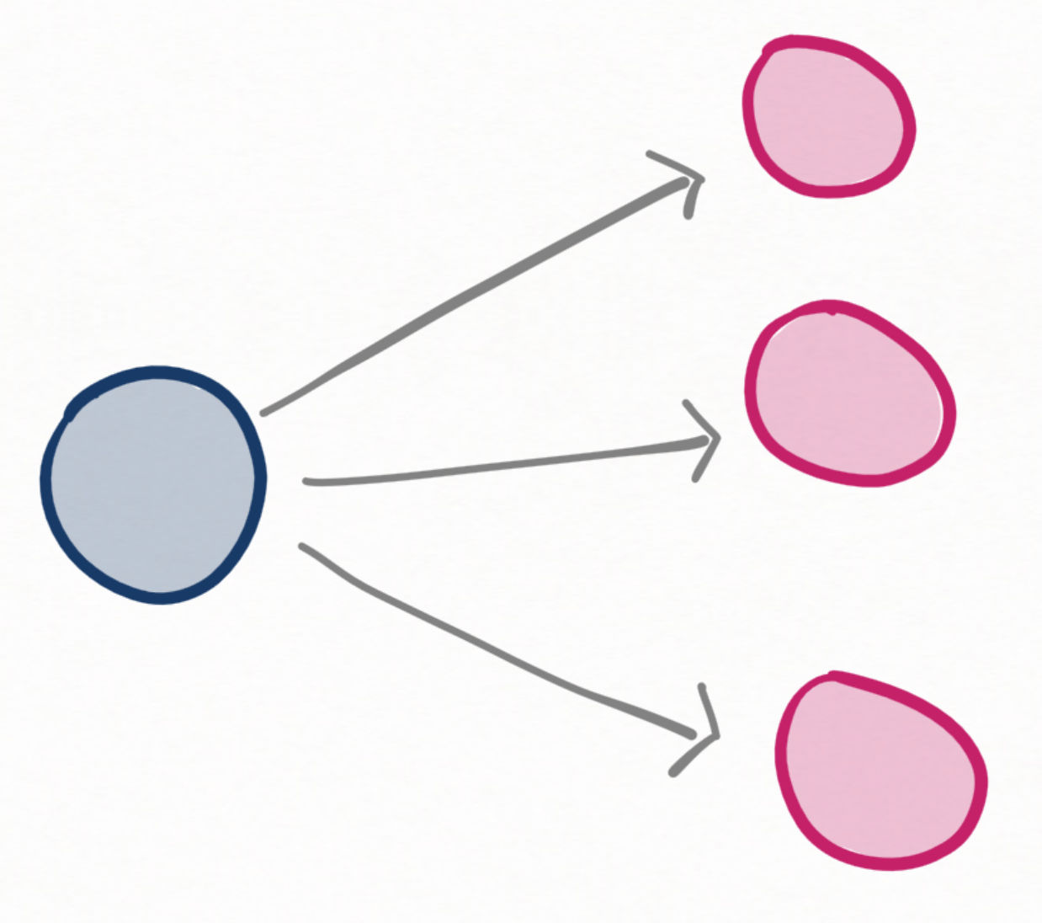
High-Dimensional Statistics: Building Blocks of ML and Data Science
Regression/PAC learning
Clustering
Component Analysis
Matrix/Tensor Factorization
Sparse Recovery/
Compressed Sensing
Community Detection
& Other Graph Problems
Latent Variable
Models
Notes:
This talk is about algorithms for high-dimensional statistics. High-dimensional statistics problems are the building blocks of machine learning and data science. These are problems like regression, clustering, PCA and its variants, sparse recovery, finding structure in networks, learning latent variable models, and more.

Slide 3
High-Dimensional Statistics: Building Blocks of ML and Data Science
Which have efficient algorithms?
What are the best algorithms for them?
Most accurate? Fastest? Most robust?
Notes:
This talk, and much of my research, focus on basic algorithmic questions in high-dimensional statistics. First, which high-dimensional statistics problems have computationally efficient algorithms? What are the best algorithms for those problems? By “best” we might mean any of several important things: what are the most accurate algorithms” The fastest algorithms” The most robust algorithms” And so on.

Slide 4
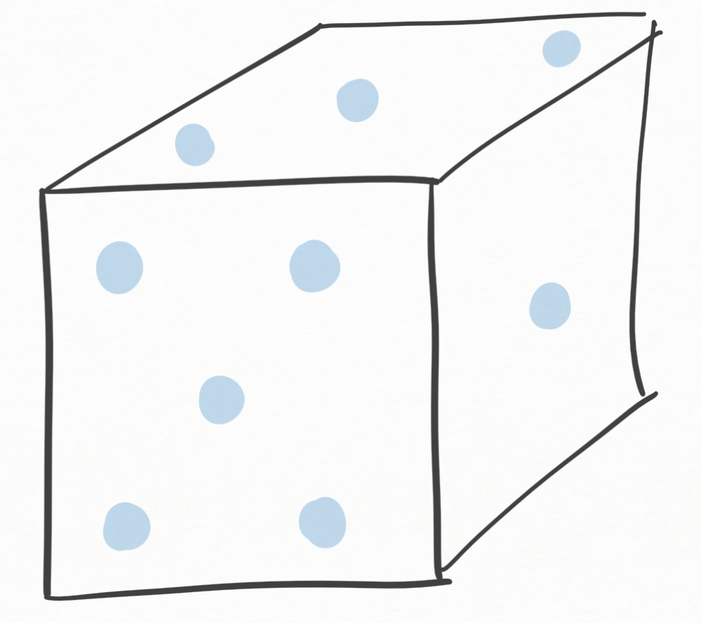
Example: Clustering
Input: $X_{1},…,X_{n}∈ℝ^{d}$
Goal: partition into clusters
Worst-case formulations typically NP hard: $k$-means, k-median…
Statistical models for data studied for 100+ years (mixture models)
But ubiquitous and useful in practice
spectral clustering, Lloyd’s algorithm, …
“When are clusters identifiable from data?”
“What is best possible accuracy?”
Too pessimistic
Non-Algorithmic
Notes:
To get a feel for the core issues, let’s zoom in on a running example, which will sustain us for much of the talk: clustering. In a typical high-dimensional clustering problem, you have a data set X1…Xn, each of which is a point in a high-dimensional space – think of the dimension d as 50 or 100 or 1000 or more. The goal is to partition the dataset in to some kind of sensible clusters.
The classic theory-of-computing approach to clustering is to treat it as a worst-case problem, and try to design algorithms which will successfully cluster any data set, for instance by optimizing the k-means or k-median objective. These worst-case formulations are typically NP-hard, so the natural conclusion is that there should not be good algorithms for clustering. But this is clearly not in line with reality: clustering is ubiquitous and useful in practice.
A different approach comes from statistics, which has studied mathematical models for non-worst-case data for more than a hundred years. There is now a rich theory giving detailed answers to questions like “under what conditions are clusters unambiguously defined by data?” and “what is the best accuracy with which it is possible to recover a ground-truth clustering from a random data set?”. But the answers to these questions are typically non-algorithmic – we know how well the data could be clustered by God, but we don’t have efficient algorithms to do it.

Slide 5
Gap between stats and worst-case analysis is pervasive
What are the fundamental tradeoffs among accuracy, statistical resources, and computational resources?
Notes:
Zooming back out to all of algorithmic statistics, this gap between classicxal statistics and worst-case analysis is pervasive across hundreds of statistics problems. But there are rich and tantalizing questions sitting squarely in the gap, like
“what are the fundamental tradeoffs among accuracy, statistical resources, and computational resources”
Answering them requires us to build theory which bridges algorithm design and statistics.

Slide 6
Algorithmic Statistics State of the Field
Islands of great success
ordinary least squares regression
LASSO/L1 minimization
tensors/method of moments
…
Surrounded by vast unexplored terrain:
Numerous basic unsolved algorithms problems
General-purpose algorithm-design principles?
Computational hardness?
Notes:
So, with all this in mind, here is my opinionated view of the state of the field of algorithmic statistics.
There are some islands of huge algorithmic success – there are classical examples like ordinary least squares regression, and more modern ones like the LASSO or L1 minimization for exploiting sparsity.
But these islands remain relatively isolated from each other – they use pretty distinct algorithmic ideas.
And they are surrounded by vast unexplored terrain – like on an old map, “there be dragons”.
In this sea of the unknown, there are numerous basic unsolved algorithms problems where worst-case analysis and classical statistics on their own don’t give us the whole algorithmic picture.
Algorithm design for these problems remains more art than science, because we lack general-purpose algorithm design principles, at least if you want algorithms with provable statistical and computational guarantees: most algorithms like this are designed on a relatively ad hoc basis.
Finally, we don’t know when to give up on a problem and reformulate it, because we have a poor understanding of computational hardness for these problems.

Slide 7
Algorithmic Statistics State of the Field
Grand Challenge: fill in the map!
Islands of great success
ordinary least squares regression
LASSO/L1 minimization
tensors/method of moments
…
Surrounded by vast unexplored terrain:
Numerous basic unsolved algorithms problems
General-purpose algorithm-design principles?
Computational hardness?
Notes:
All of this suggests a grand challenge, which is to fill in the algorithmic map of statistics

Slide 8
My work: develop principled tools in optimization to fill in algorithmic map of statistics
Optimization
Linear Programming
Spectral Methods
Semidefinite Programming
Sum of Squares Method
Algorithmic Statistics
Notes:
My work builds towards this by bridging optimization and algorithm-design for statistics. I develop new tools in optimization and apply them to build principled algorithms for computationally-challenging problems in statistics.

Slide 9
Talk Plan
Theme: Proofs to Algorithms
novel, principled approach to algorithmic statistics
Part 1:
beating greedy clustering for Gaussian mixture models
[H-Li STOC 2018]
Part 2:
optimal confidence intervals for heavy-tailed statistics
[H Annals of Statistics 2019]
[Cherapanamjeri-H-Kathuria-Raghavendra-Tripuraneni STOC 2020]
[Dong-H-Li NeurIPS 19 (Spotlight)]
Notes:
This talk is about one particularly powerful bridge between optimization and statistics which emerges from my work, called “Proofs to Algorithms”. Of course using optimization as a tool for statistics has a long history, but the Proofs to Algorithms perspective is quite novel and has led to some major algorithmic breakthroughs in just the last few years.
I’ll illustrate Proofs to Algorithms with two major applications. The first is to design a new algorithm for high-dimensional clustering, which is the first to beat the guarantees of greedy clustering for high-dimensional Gaussian mixture models. This was the first use of Proofs to Algorithms to break open a long-studied statistics problem.
Then I will turn to a line of work using Proofs to Algorithms to design algorithms for fundamental problems in heavy-tailed and robust statistics – that is, statistics with nasty data.

Slide 10
Part I: Clustering and Mixture Models [H-Li STOC 18]
Notes:
So, let’s turn to clustering.

Slide 11
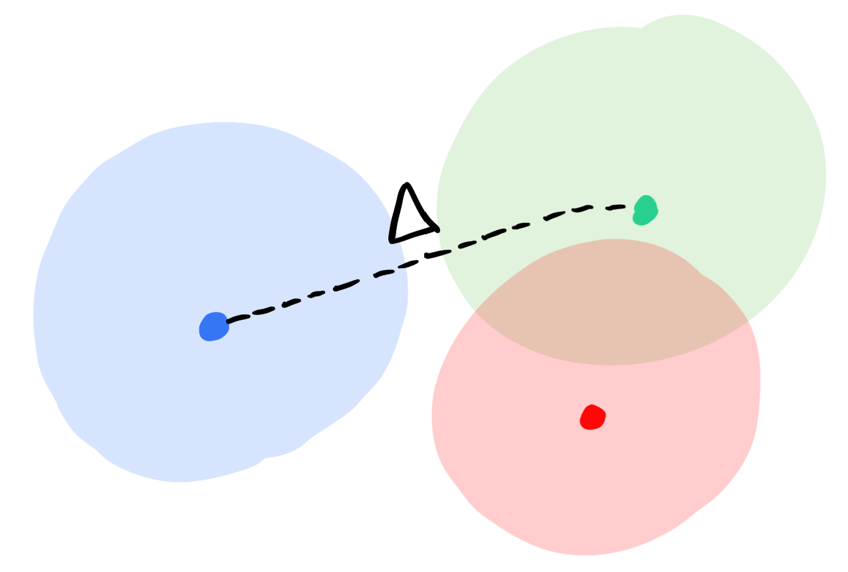
Gaussian Mixture Models
Get: $X_{1},…,X_{n}∈ℝ^{d}$ each from random one of $k$ Gaussians
Goal: cluster the samples, $poly(d,k)$ time
Origins: [Pearson 1894]
Ubiquity:
in every data science software package
Measure of difficulty: cluster separation $Δ$
Notes:
We will address the most elementary clustering model from statistics: the Gaussian mixture model.
Our data will consist of n vectors in d dimensions, each drawn from

Slide 12
Gaussian Mixture Models
Question 1 (“Identifiability”):
When do samples determine unique clustering?
Answer: if and only if $Δ≫\sqrt{\log{k}}$
Brute-force search finds correct clustering
Question 2 (Algorithms): Polynomial time?
1894-2018: greedy clustering (+ preprocessing), $Δ≫k^{\frac{1}{4}}$
Exponential gap between “classical stats” and algorithms!
[H-Li STOC 18, Kothari-Steinhart-Steurer STOC 18, Diakonikolas-Kane-Stewart STOC 18, Vempala-Wang FOCS 02, Dasgupta FOCS 99, Dasgupta-Schulman JMLR 07, Hsu-Kakade ITCS 13, Ge-Huang-Kakade STOC 15, Arora-Kannan Ann. Appl. Probab. 05]

Slide 13
Gaussian Mixture Models
Brute force: $Δ≫\sqrt{\log{k}}$ Greedy: $Δ≫k^{\frac{1}{4}}$
Theorem: For every $ε>0$, cluster in polynomial time if $Δ≥k^{ε}$, $d^{\log{k}}$ time if $Δ≫\sqrt{\log{k}}$.
[H-Li STOC 2018, Kothari-Steinhart-Steurer STOC 18, Diakonikolas-Kane-Stewart STOC 18]
First to beat greedy!

Slide 14
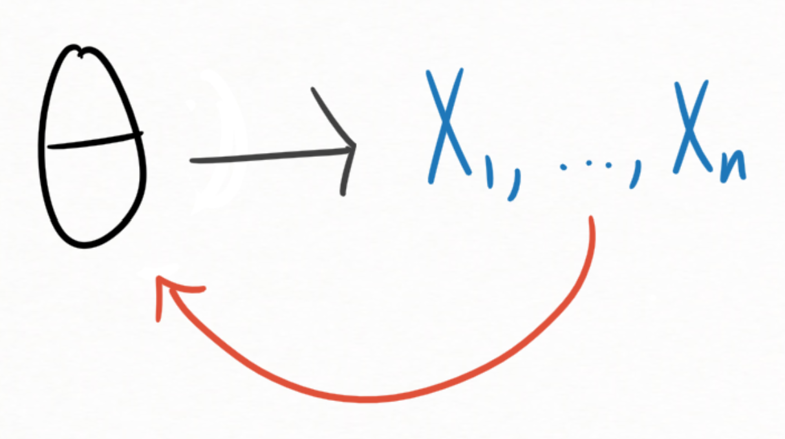
Probabilistic process
Typical approach:
Identifiability
“samples determine parameters”
Forget step 1.
Design efficient algorithm
Rigorously analyze algorithm
(efficient) algorithm
Proofs to Algorithms
Prove identifiability via simple proof
Mechanically transform simple proof into efficient algorithm
Rigorous analysis for free

Slide 15
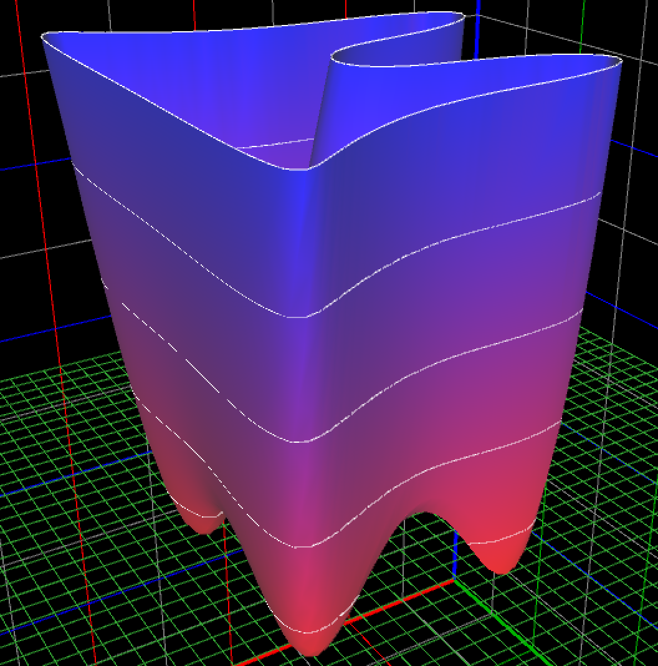
Key tool: Sum of Squares Method (SoS) from polynomial optimization

Slide 16
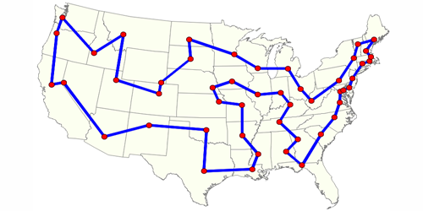
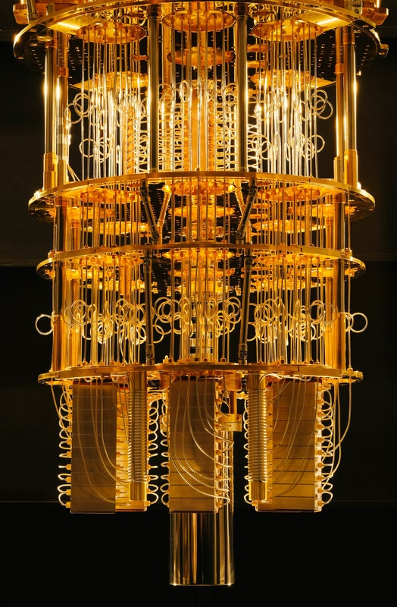
Major Algorithmic Success
Robotics/optimal control
Polynomial Optimization &
Sum of Squares Method
convex programs subsuming LP, SDP, spectral methods
Combinatorial optimization
Quantum information
Statistics
Proofs to algorithms
Cryptography

Slide 17
SoS Crash Course
Algorithm for solving systems of polynomial inequalities [Parrilo 00, Lasserre 02]
$p_{1}\left(x\right)≥0,…,p_{m}\left(x\right)≥0$, $x=x_{1},…,x_{n}$
When does it work?

Slide 18
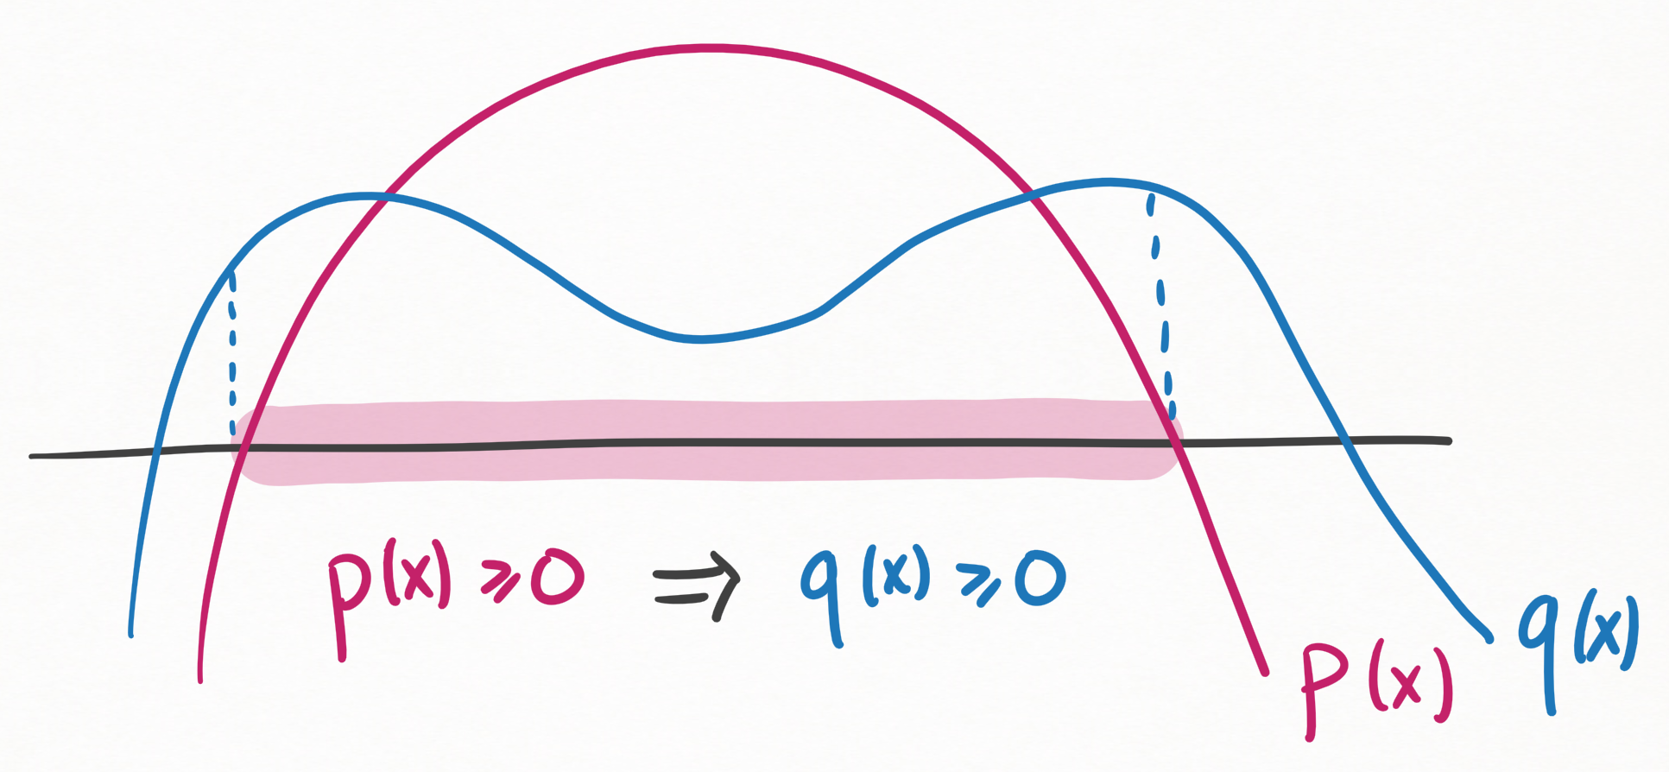
SoS Crash Course
Formal proof system for polynomial inequalities
“$p_{1}\left(x\right)≥0,…,p_{m}\left(x\right)≥0$ implies $q\left(x\right)≥0$”

Slide 19
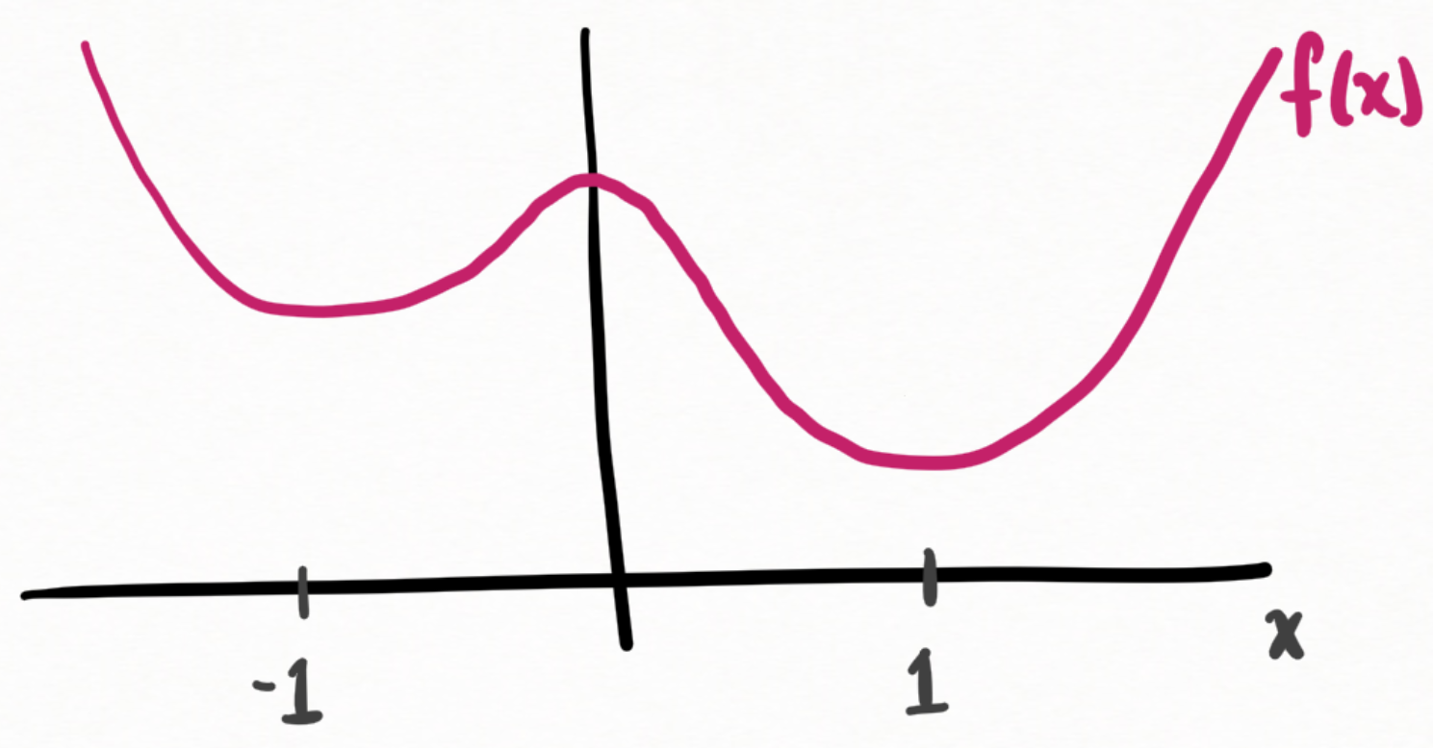
SoS Crash Course
Formal proof system for polynomial inequalities
“$p_{1}\left(x\right)≥0,…,p_{m}\left(x\right)≥0$ implies $q\left(x\right)≥0$”
Proofs rely on nonnegativity of squares
Ex: prove $f\left(x\right)=x^{4}−1.8x^{2}−0.4x+2.2$ is always $≥1$
$$f\left(x\right)=1+ {\left(x−1\right)}^{2}⋅\left({\left(x+1\right)}^{2}+{\sqrt{0.2}}^{2}\right)$$

Slide 20
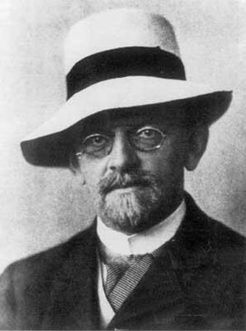
SoS Crash Course
Formal proof system for polynomial inequalities
“$p_{1}\left(x\right)≥0,…,p_{m}\left(x\right)≥0$ implies $q\left(x\right)≥0$”
Proofs rely on nonnegativity of squares
Hilbert, Krivine-Stengle (1888-1974):
Every true statement has an SoS proof!
“Degree-d proof” nonnegativity of degree-d squares

Slide 21
SoS Crash Course
$$p_{1}\left(x\right)≥0,…,p_{m}\left(x\right)≥0$$
When does SoS algorithm work?
10,000 foot view:
Solutions characterized in degree-$d$ SoS proof system ⇨ SoS algorithm finds solution in $n^{O(d)}$ time
Equation solving power vs running time tradeoff!

Slide 22
Proofs to Algorithms Black Box
Proofs to Algorithms
$$p_{1}\left(x\right)≥0$$
$$…$$
$$p_{m}\left(x\right)≥0$$
SoS
$x$ s.t.
$${\left\|x−x^{∗}\right\|}^{2}≤ε$$
s.t. all solutions $x$ have ${\left\|x −x^{∗}\right\|}^{2}≤ε$
SoS proof that
$p_{1}\left(x\right)≥0,…p_{m}\left(x\right)≥0$ implies ${\left\|x−x^{∗}\right\|}^{2}≤ε$

Slide 23
Proofs to Algorithms Black Box
Proofs to Algorithms
$$p_{1}\left(x\right)≥0$$
$$…$$
$$p_{m}\left(x\right)≥0$$
SoS
$x$ s.t.
$${\left\|x−x^{∗}\right\|}^{2}≤ε$$
s.t. all solutions $x$ have ${\left\|x −x^{∗}\right\|}^{2}≤ε$
SoS proof that
$p_{1}\left(x\right)≥0,…p_{m}\left(x\right)≥0$ implies ${\left\|x−x^{∗}\right\|}^{2}≤ε$

Slide 24
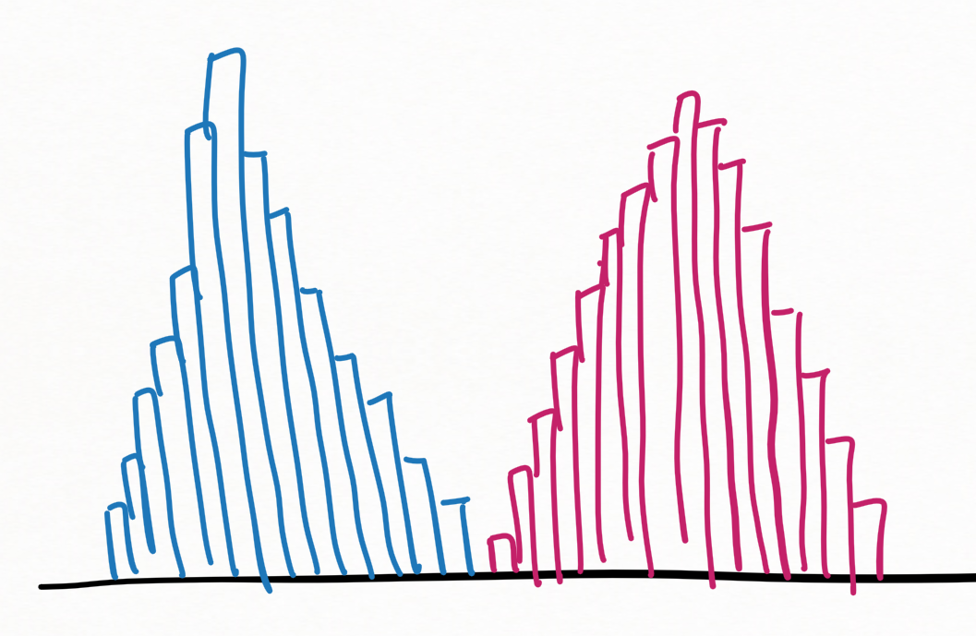
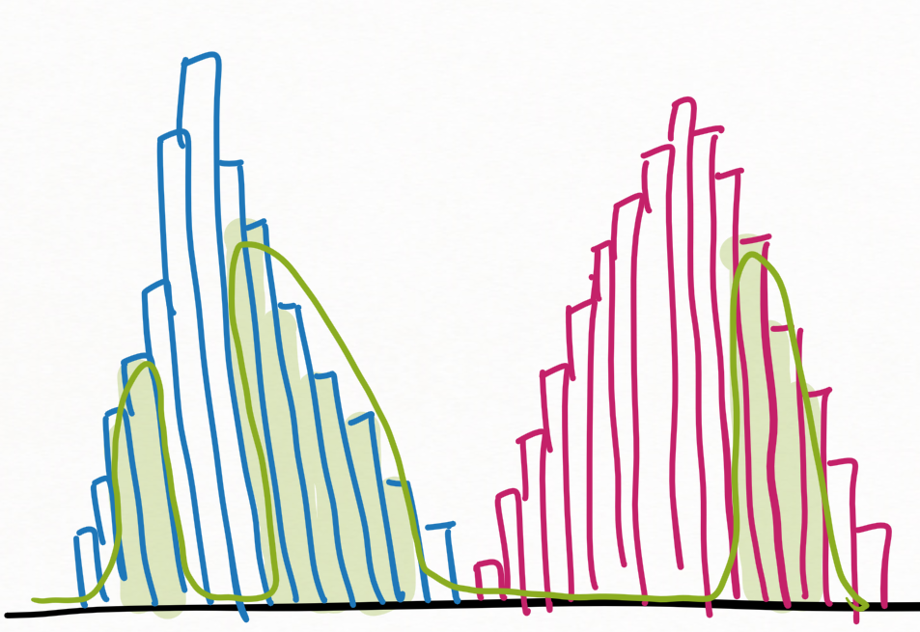
Proofs to Algorithms for Mixture Models
Identifiability: if $Δ≫\sqrt{\log{k}}$, clusters are unambiguous.
Proof: $S⊆\{X_{1},…,X_{n}\}$ is $≈$ a ground-truth cluster iff empirical distribution of $S$is $≈$ Gaussian
Samples $X_{1},…,X_{n}$
from $k$ Gaussians

Slide 25
Proofs to Algorithms for Mixture Models
Identifiability: if $Δ≫\sqrt{\log{k}}$, clusters are unambiguous.
Proof: $S⊆\{X_{1},…,X_{n}\}$ is $≈$ a ground-truth cluster iff empirical distribution of $S$is $≈$ Gaussian
Samples $X_{1},…,X_{n}$
from $k$ Gaussians
New goal: find partition into subsets with Gaussian empirical distributions
1. Encode as polynomials
$w=w_{1}^{1},w_{1}^{2},…w_{n}^{1},…w_{n}^{k}$ represents partition into Gaussian subsets
⬄ $p_{1}\left(w\right)≥0,…p_{m}\left(w\right)≥0$
2. Use Proofs to Algorithms black box

Slide 26
1. Encode as polynomials
$w=w_{1}^{1},w_{1}^{2},…w_{n}^{1},…w_{n}^{k}$ represents partition into Gaussian subsets
⬄ $p_{1}\left(w\right)≥0,…p_{m}\left(w\right)≥0$
$w_{i}^{j}∈\{0,1\}$ ⬄ ${\left(w_{i}^{j}\right)}^{2}=w_{i}^{j}$
every sample in exactly one cluster ⬄…
every cluster has size $≈\frac{n}{k}$ ⬄…
$$…$$
$j$th cluster has correct covariance ⬄
$${\left\|covariance of jth cluster\left(w\right)−I\right\|}^{2}≤0.01$$
…

Slide 27
Proofs to Algorithms for Mixture Models
Identifiability: if $Δ≫\sqrt{\log{k}}$, clusters are unambiguous.
Proof: $S⊆\{X_{1},…,X_{n}\}$ is $≈$ a ground-truth cluster iff empirical distribution of $S$is $≈$ Gaussian
Samples $X_{1},…,X_{n}$
from $k$ Gaussians
New goal: find partition into subsets with Gaussian empirical distributions
1. Encode as polynomials
$w=w_{1}^{1},w_{1}^{2},…w_{n}^{1},…w_{n}^{k}$ represents partition into Gaussian subsets
⬄ $p_{1}\left(w\right)≥0,…p_{m}\left(w\right)≥0$
2. Use Proofs to Algorithms black box

Slide 28
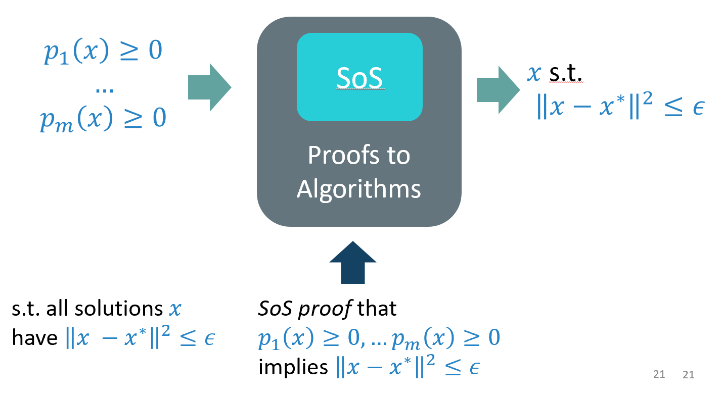
Proofs to Algorithms for Mixture Models
Identifiability: if $Δ≫\sqrt{\log{k}}$, clusters are unambiguous.
Proof: $S⊆\{X_{1},…,X_{n}\}$ is $≈$ a ground-truth cluster iff empirical distribution of $S$is $≈$ Gaussian
Samples $X_{1},…,X_{n}$
from $k$ Gaussians
2. Use Proofs to Algorithms black box
Need:
unique solution
SoS proof of uniqueness

Slide 29
Proofs to Algorithms for Mixture Models
Identifiability: if $Δ≫\sqrt{\log{k}}$, clusters are unambiguous.
Proof: $S⊆\{X_{1},…,X_{n}\}$ is $≈$ a ground-truth cluster iff empirical distribution of $S$is $≈$ Gaussian
Samples $X_{1},…,X_{n}$
from $k$ Gaussians
2. Use Proofs to Algorithms black box
unique solution:
solutions to $p_{1}\left(w\right)≥0,…,p_{m}\left(w\right)≥0$
⬄ partition into Gaussian clusters
⬄ ground-truth clusters
which are unique!

Slide 30
Proofs to Algorithms for Mixture Models
Identifiability: if $Δ≫\sqrt{\log{k}}$, clusters are unambiguous.
Proof: $S⊆\{X_{1},…,X_{n}\}$ is $≈$ a ground-truth cluster iff empirical distribution of $S$is $≈$ Gaussian
Samples $X_{1},…,X_{n}$
from $k$ Gaussians
2. Use Proofs to Algorithms black box
unique solution:
Identifiability ⇨ unique solution!

Slide 31
Proofs to Algorithms for Mixture Models
Identifiability: if $Δ≫\sqrt{\log{k}}$, clusters are unambiguous.
Proof: $S⊆\{X_{1},…,X_{n}\}$ is $≈$ a ground-truth cluster iff empirical distribution of $S$is $≈$ Gaussian
Samples $X_{1},…,X_{n}$
from $k$ Gaussians
2. Use Proofs to Algorithms black box
Need:
unique solution
SoS proof of uniqueness

Slide 32
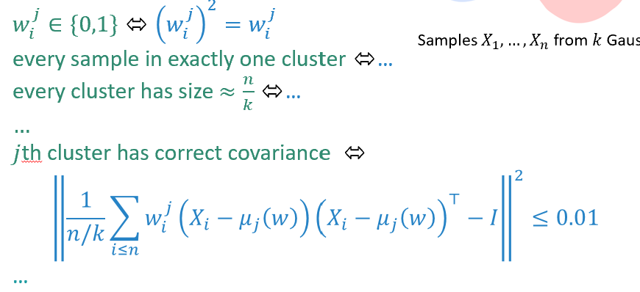
Proofs to Algorithms for Mixture Models
Identifiability: if $Δ≫\sqrt{\log{k}}$, clusters are unambiguous.
Proof: $S⊆\{X_{1},…,X_{n}\}$ is $≈$ a ground-truth cluster iff empirical distribution of $S$is $≈$ Gaussian
Samples $X_{1},…,X_{n}$
from $k$ Gaussians
SoS proof of uniqueness
2. Use Proofs to Algorithms black box
(Sequence of constant-degree polynomial inequalities)
$${\left\|w−ground truth clustering\right\|}^{2}≤0.01$$

Slide 33
Proofs to Algorithms for Mixture Models
Identifiability: if $Δ≫\sqrt{\log{k}}$, clusters are unambiguous.
Proof: $S⊆\{X_{1},…,X_{n}\}$ is $≈$ a ground-truth cluster iff empirical distribution of $S$is $≈$ Gaussian
Samples $X_{1},…,X_{n}$
from $k$ Gaussians
2. Use Proofs to Algorithms black box
Need:
unique solution
SoS proof of uniqueness

Slide 34
Identifiability: if $Δ≫\sqrt{\log{k}}$, clusters are unambiguous.
Proof: $S⊆\{X_{1},…,X_{n}\}$ is $≈$ a ground-truth cluster iff empirical distribution of $S$is $≈$ Gaussian
To prove: Gaussian-like subsets of samples are $≈$ ground-truth clusters
$S$ = a subset of samples
1. $S$ contains samples from $>1$ cluster, then $S$ has high variance
2. Gaussian subsets have bounded variance
3. So, $S$ is not good
(Sequence of constant-degree polynomial inequalities)
Encode in constant-degree SoS
$${\left\|w−w^{∗}\right\|}^{2}≤0.01$$
Ground-truth clustering

Slide 35
What we did
Start with proof of identifiability
“samples determine unique clustering”
Encode in constant-degree SoS
Payoff: first algorithm to beat greedy
Not a clustering-specific strategy!

Slide 36
Proofs to Algorithms
Not a clustering-specific strategy!
SoS
Generic problem: estimate parameters $θ$ from samples $X_{1},…,X_{n}∼P_{θ}$
Identifiability: samples determine parameters
Necessary to estimate $θ$
Proof of identifiability in constant-degree SoS
⇨ poly-time algorithm to estimate $θ$

Slide 37
Scope
Proofs to Algorithms
SoS
Origins:
Breaking old barriers in clustering
[H-Li STOC 18, Kothari-Steinhart-Steurer STOC 18]
Ongoing Explosion:
Heavy-tailed statistics:
[H Annals of Statistics 19,
Cherapanamjeri-H-Kathuria-Raghavendra-Tripuraneni STOC 20]
Robust & mixed regression:
[Klivans-Kothari-Meka COLT 19,
Karmalkar-Klivans-Kothari NeurIPS 19, Raghavendra-Yao SODA 20]
Federated learning: [Chen-Li-Moitra STOC 20]
Robust clustering: [Diakonikolas-H-Kane-Karmalkar, Jia-Vempala]
New Lens on Greatest Hits:
captures strongest known algs for matrix completion,
compressed sensing, community detection, …

Slide 38
Part II: Heavy-Tailed and Robust Statistics [H Annals of Statistics 19] [Cherapanamjeri-H-Kathuria-Raghavendra-Tripuraneni STOC 20] [Dong-H-Li NeurIPS 19 (Spotlight)]

Slide 39
Estimating the Mean of a (Heavy-Tailed) Random Vector [H Annals of Statistics 19]
Context: explosion of efficient algorithms for high-dimensional robust statistics (2016—present)

Slide 40
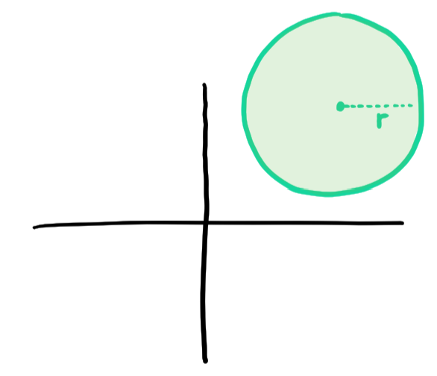
Task: estimate the mean with confidence intervals
Input: $X_{1},…,X_{n}∼D$.
Goal: estimate $μ= 𝔼_{X∼D}X$ by $\hat{μ}(X_{1},…,X_{n})$
Measure of Success:
$\left\|\hat{μ}−μ\right\|≤r(δ)$ with probability at least $1−δ$
(“p-value”)

Slide 41
Task: estimate the mean with confidence intervals
Input: $X_{1},…,X_{n}∼D$.
Goal: estimate $μ= 𝔼_{X∼D}X$ by $\hat{μ}(X_{1},…,X_{n})$
Measure of Success:
$\left\|\hat{μ}−μ\right\|≤r(δ)$ with probability at least $1−δ$
(“p-value”)
Sample mean:
$\frac{1}{n}\sum{X_{i}}$ is good for nice data
(population is Gaussian)

Slide 42
Task: estimate the mean with confidence intervals
Input: $X_{1},…,X_{n}∼D$.
Goal: estimate $μ= 𝔼_{X∼D}X$ by $\hat{μ}(X_{1},…,X_{n})$
Measure of Success:
$\left\|\hat{μ}−μ\right\|≤r(δ)$ with probability at least $1−δ$
(“p-value”)
What if the population is nasty?

Slide 43
What if the population is nasty?
“I am 95% confident that the average US household financial holdings are $339,900 $±$ ??”
https://www.federalreserve.gov/econres/scfindex.htm
Confidence intervals for sample mean are much worse than for nice (Gaussian) data!

Slide 44
Confidence intervals for sample mean are much worse than for nice (Gaussian) data!
Amazing fact (classical): median-based estimators maintain small confidence intervals!
(as good as if pop. were Gaussian)
median
(median of means)
sample mean

Slide 45
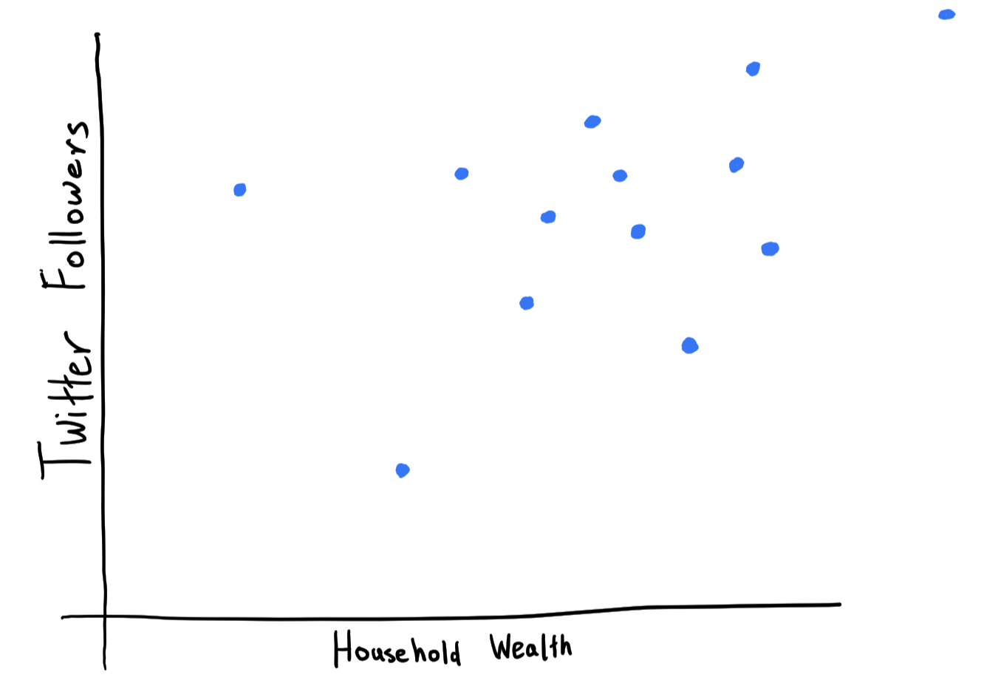

Slide 46
How do you estimate the population average of a
high-dimensional,
heavy-tailed,
distribution and obtain small (optimal) confidence intervals?
What is the median in high dimensions?

Slide 47
Naïve approaches: suboptimal confidence intervals
1960s – 2018: Definition of high-dimensional median with optimal confidence intervals
Naïve algorithms: $exp⁡(dimension)$ time
[H Annals of Statistics 19]: High-dimensional median in polynomial time!
First optimal confidence intervals
[Tukey 60,…,Lugosi-Mendelson 18, Johnson-Preparata 78]

Slide 48
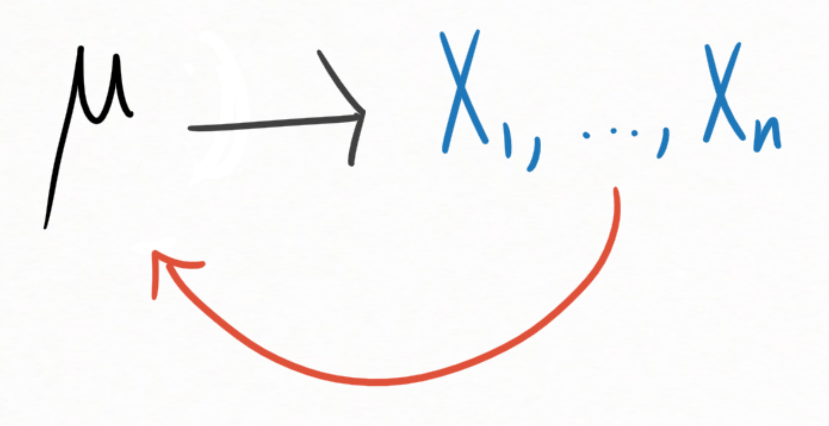
[H Annals of Statistics 19]: High-dimensional median in polynomial time!
First optimal confidence intervals
Input: $X_{1},…,X_{n}∼D$, finite variance in all directions.
Goal: estimate $μ= 𝔼_{X∼D}X$ by $\hat{μ}(X_{1},…,X_{n})$
Identifiability: high-dimensional median of $X_{1},…,X_{n}$ identifies $μ$ up to optimal error
[Lugosi-Mendelson Annals of Statistics 18]
Strategy: Proofs to Algorithms!
Polynomials can talk about medians!

Slide 49
Beyond the Mean: Regression and Covariance Estimation [Cherapanamjeri-H-Kathuria-Raghavendra-Tripuraneni STOC 20]

Slide 50
Linear Regression
Goal: make predictions based on examples
Ex: predict wealth as function of
# twitter followers
# facebook friends
# packets through your router
…
Heavy-tailed features
Classical approaches only optimal for nice data
Our result: new polynomial-time algorithm smallest known errors for heavy-tailed data, via Proofs to Algorithms

Slide 51
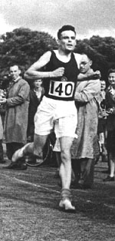
How Fast Can You Go?

Slide 52
[H Annals of Statistics 19]: High-dimensional median in polynomial time!
First optimal confidence intervals
November 2018
OK… $O(n^{28})$ time
June 2019: $O(n^{4})$ time [Cherapanamjeri-Flammarion-Bartlett COLT19]
December 2019: $\tilde{O}(n^{2})$time [Depersin-Lecue 19, Lei-Luh-Venkat-Zhang 19]
Also December 2019: $\tilde{O}(n)$time, with code
(adversarial robustness instead of confidence intervals)
[Dong-H-Li NeurIPS 19 Spotlight]

Slide 53
[H Annals of Statistics 19]: High-dimensional median in polynomial time!
First optimal confidence intervals
November 2018
OK… $O(n^{28})$ time
Line of work on speeding up SoS-based algorithms:
[H-Shi-Steurer COLT 15, H-Schramm-Shi-Steurer STOC 16, H-Schramm-Shi COLT 19, Dong-H-Li NeurIPS 19]
June 2019: $O(n^{4})$ time [Cherapanamjeri-Flammarion-Bartlett COLT19]
December 2019: $\tilde{O}(n^{2})$time [Depersin-Lecue 19, Lei-Luh-Venkat-Zhang 19]
Also December 2019: $\tilde{O}(n)$time, with code
(adversarial robustness instead of confidence intervals)
[Dong-H-Li NeurIPS 19 Spotlight]

Slide 54
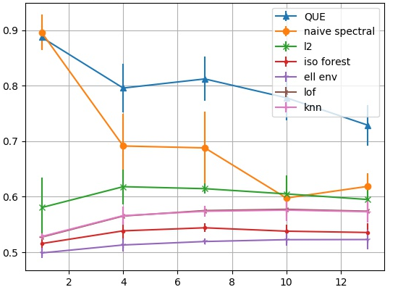
Experiment [DHL NeurIPS 19 (Spotlight)]
Task: find the outliers in a high-dimensional corrupted data set
our method outperforms nearest-neighbor methods
scoring performance
# distinct outlier types
(distinct pixels corrupted)

Slide 55
Zooming out…
Notes:
Let’s zoom back out to the big picture

Slide 56
Optimization
Sum of Squares Method,
Linear Programming,
Multiplicative Weights,
Spectral Methods, …
Algorithmic Statistics
Medians, clustering, tensor decomposition, latent variable models, regression, community detection, …
Notes:
In this talk we saw one particularly fruitful bridge between optimization and algorithmic statistics: the Proofs to Algorithms method, which we leveraged to build a new clustering algorithm and new algorithms for elementary problems in heavy-tailed statistics.

Slide 57
Optimization
Sum of Squares Method,
Linear Programming,
Multiplicative Weights,
Spectral Methods, …
Algorithmic Statistics
Medians, clustering, tensor decomposition, latent variable models, regression, community detection, …
Lower Bounds
Limitations of Proofs to Algorithms, Sum of Squares Method
[H-Shi-Steurer COLT 2015]
[H-Kothari-Potechin-Raghavendra-Schramm SODA 2016]
[Barak-H-Kothari-Kelner-Moitra-Potechin FOCS 16]
[H-Kothari-Potechin-Raghavendra-Schramm-Steurer FOCS 17]
[H-Steurer FOCS 17]
[H-Li COLT 19]
Notes:
Because I want to draw a complete map of the algorithmic landscape of statistics, I also study computational lower bounds for statistics problems, focusing on the inherent limitations of powerful optimization tools like the sum of squares method. My work introduced a major new technique for proving such lower bounds, called “pseudocalibration”.

Slide 58
Optimization
Sum of Squares Method,
Linear Programming,
Multiplicative Weights,
Spectral Methods, …
Algorithmic Statistics
Medians, clustering, tensor decomposition, latent variable models, regression, community detection, …
Lower Bounds
Limitations of Proofs to Algorithms, Sum of Squares Method
[H-Shi-Steurer COLT 2015]
[H-Kothari-Potechin-Raghavendra-Schramm SODA 2016]
[Barak-H-Kothari-Kelner-Moitra-Potechin FOCS 16]
[H-Kothari-Potechin-Raghavendra-Schramm-Steurer FOCS 17]
[H-Steurer FOCS 17]
[H-Li COLT 19]
Cryptography
[Barak-H-Jain-Kothari-Sahai Eurocrypt 19]
Combinatorics, Combinatorial Optimization
[H-Schramm-Trevisan 20]
Notes:
In this talk we mostly saw ideas in optimization enabling new algorithms in statistics. But the connection goes both ways. For instance, my work has used subtle properties of random graphs, first studied in probability and statistics, to understand classic combinatorial optimization problems. And similarly, I have drawn inspiration from statistics ideas to analyze optimization algorithms which break important candidate pseudo-random generators in cryptography.

Slide 59
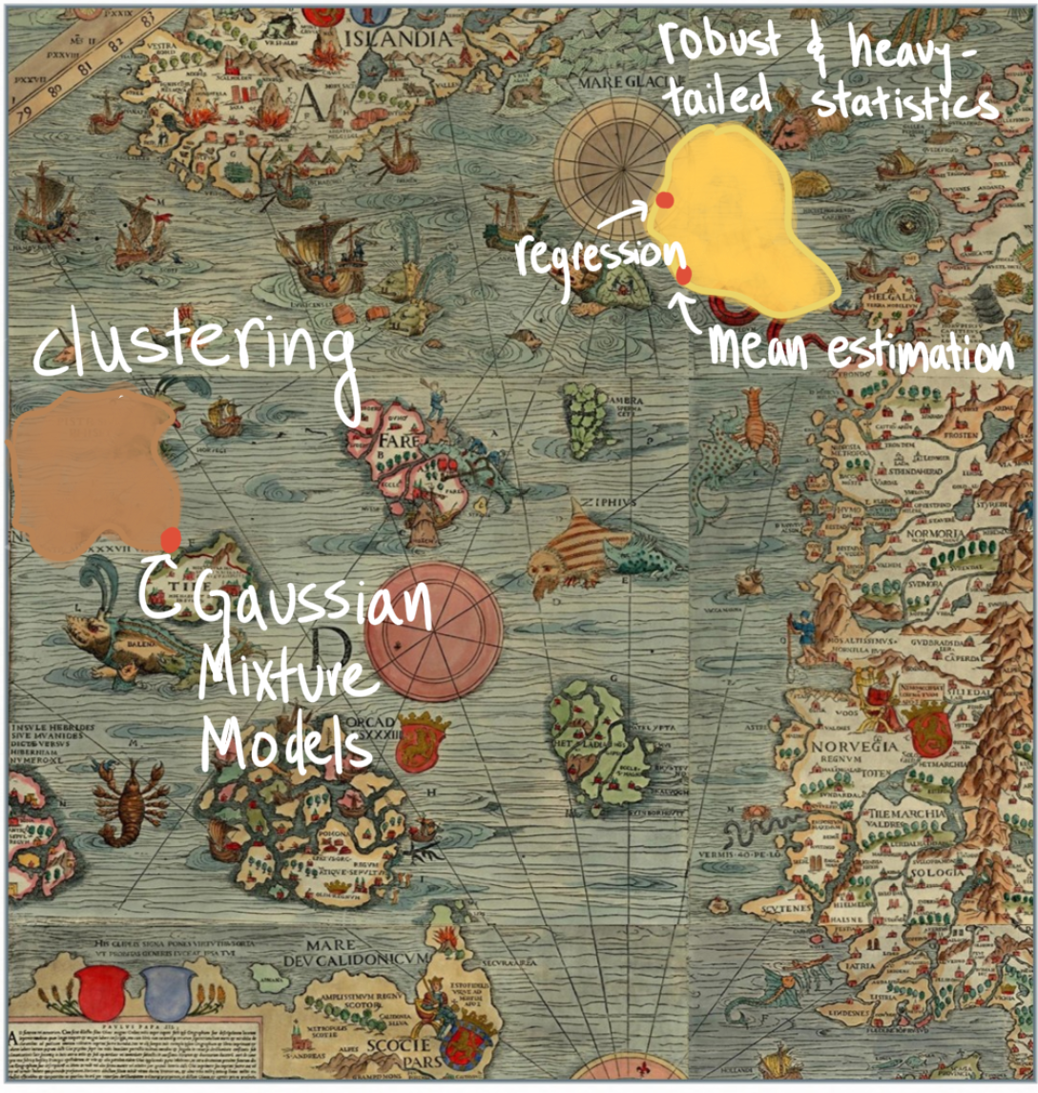
Future Work
Notes:
Although we covered some significant algorithm-design progress in this talk, the new algorithms we saw ultimately amount just to small dots on a still-largely-unexplored map. (This map is not drawn to scale.)

Slide 60
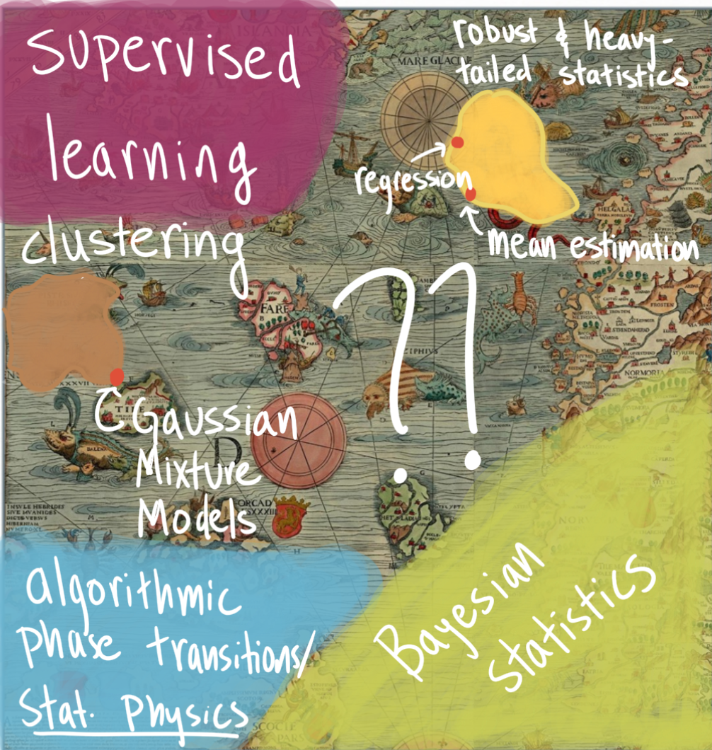
Future Work
Notes:
With the techniques we developed, like Proofs to Algorithms, and new ones which will surely emerge from continuing to connect optimization and statistics, I’m really excited about where we can go next.
Most of the problems we talked about today are “unsupervised” learning problems. There are major problems in supervised learning which haven’t seen algorithmic progress in a decade, but I believe we should begin to be able to tackle some of them using Proofs to Algorithms.
And then there are these major mysterious regions at the bottom of the map, which are not drawn to scale. Essentially everything we discussed today was about frequentist statistics. But Bayesian statistics is equally important, and there are a host of computational problems where we don’t understand what is algorithmically possible. I’m excited to apply this optimization lens to Bayesian statistics.
Methods from statistical physics can be used to relate algorithms and their success or failure for statistics problems to the mathematics of freezing and melting and vaporization – the mathematics of phase transitions. This opens up an exciting possibility of using physics methods to understand optimization, and optimization to understand statistical physics.

Slide 61
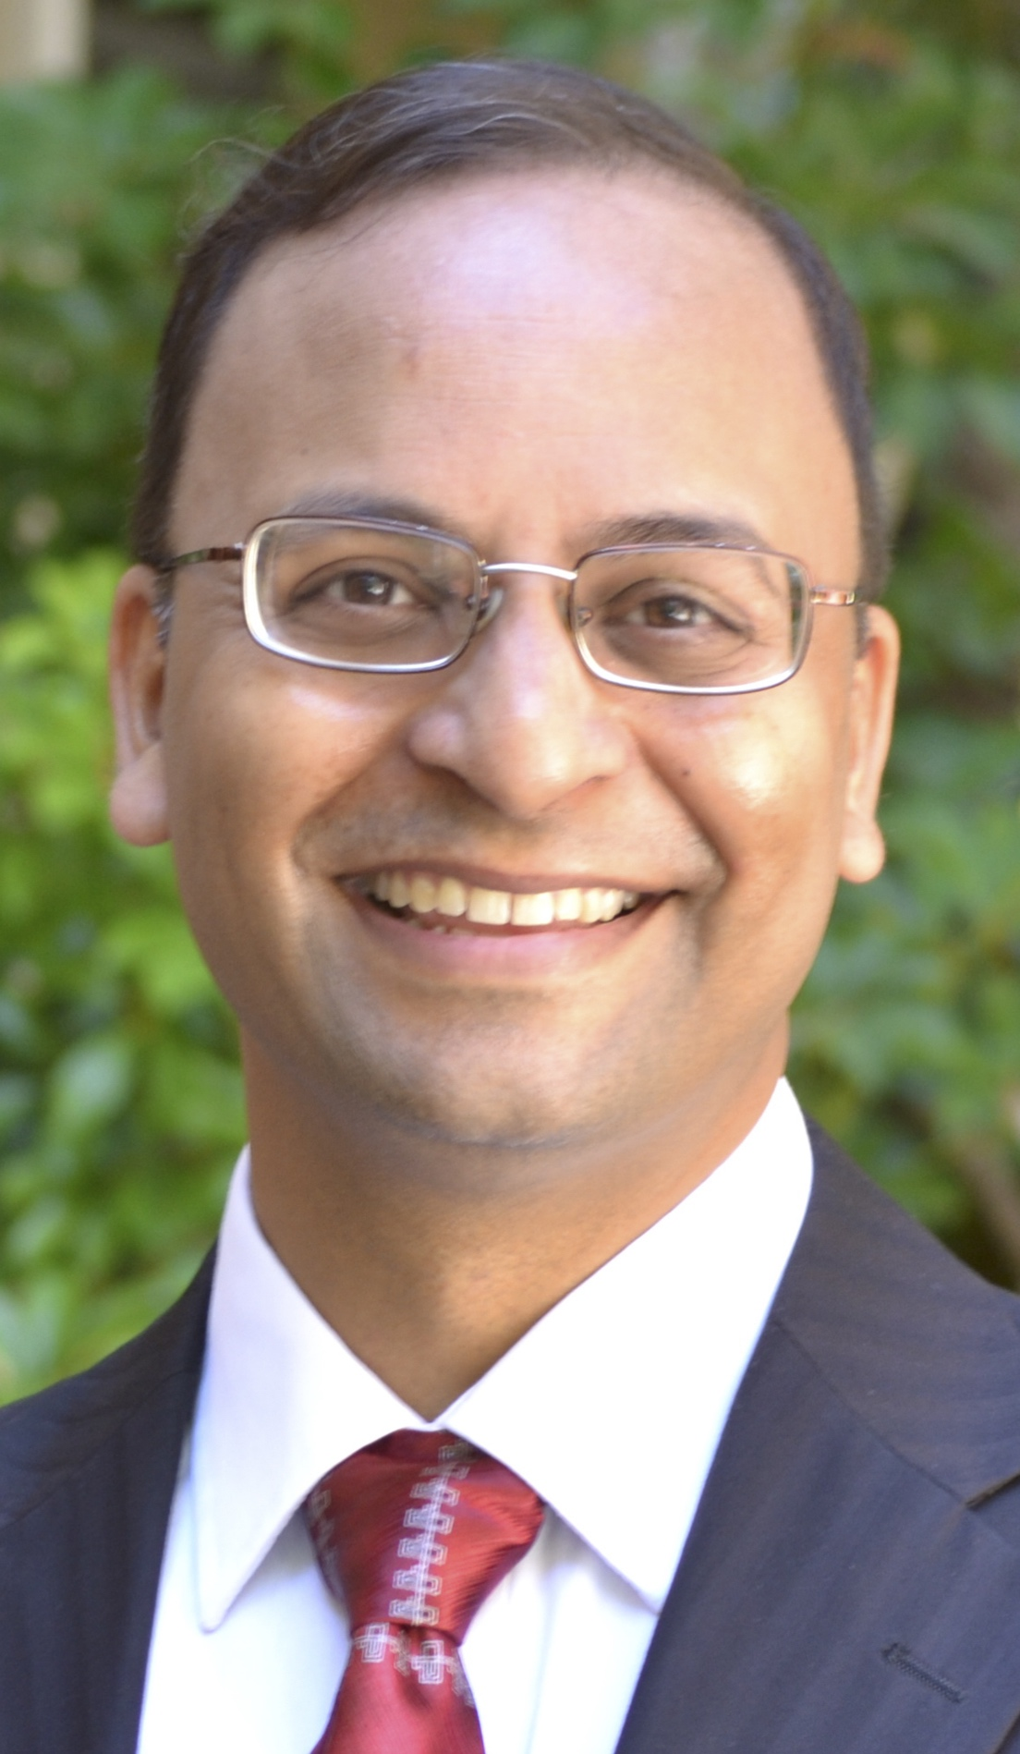
Thanks!

